Slide 1
10 things I am passionate about…
By Aysha Adam

Slide 2

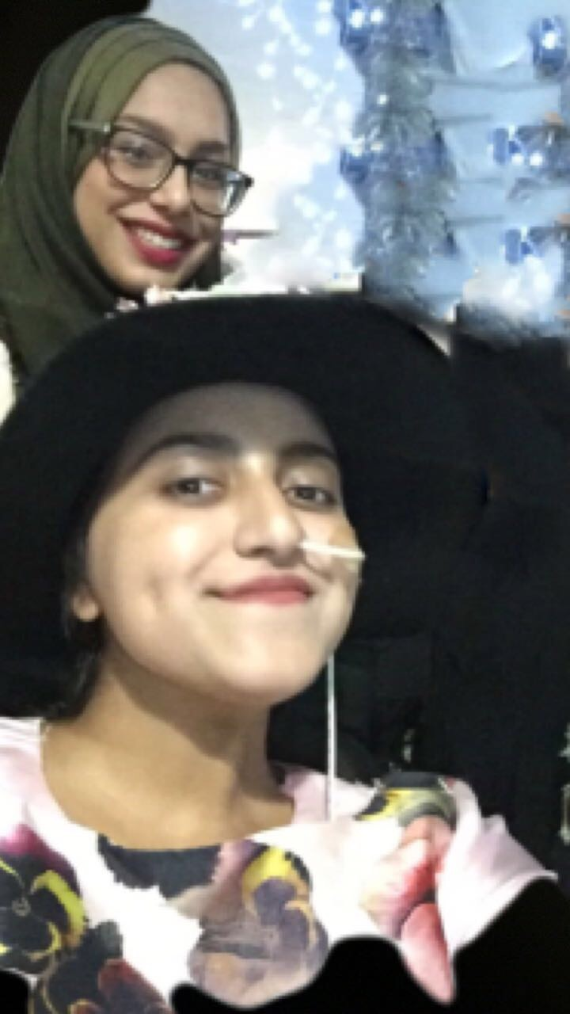
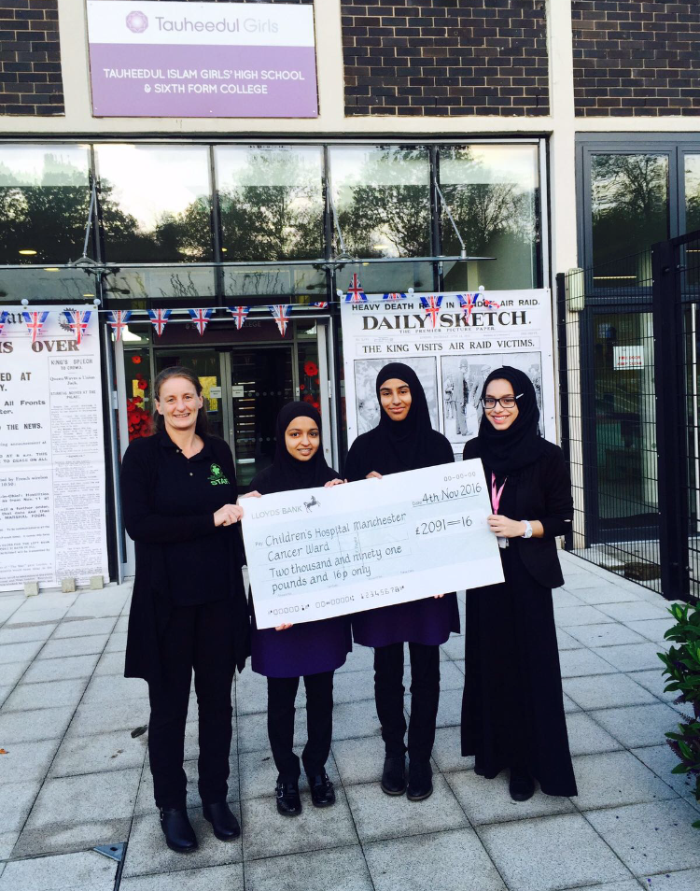
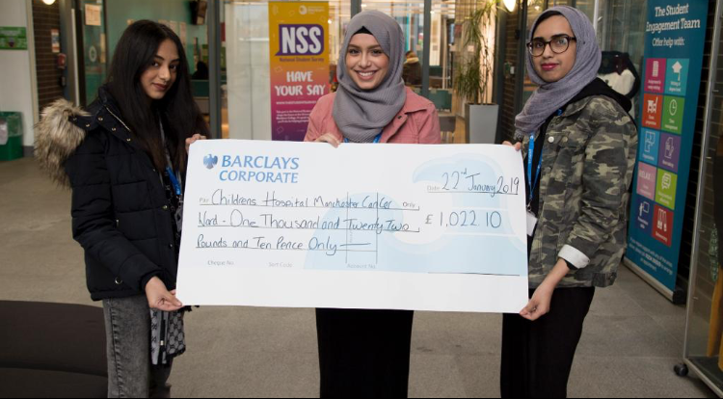
1. Manchester Children’s Hospital- brain tumour ward
2018- £1022.10
2016- £2091.16

Slide 3

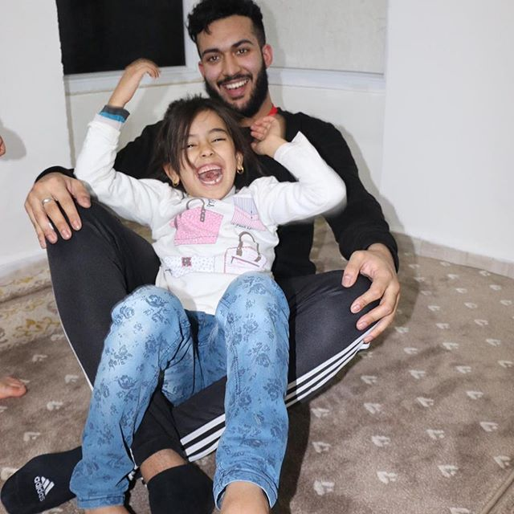

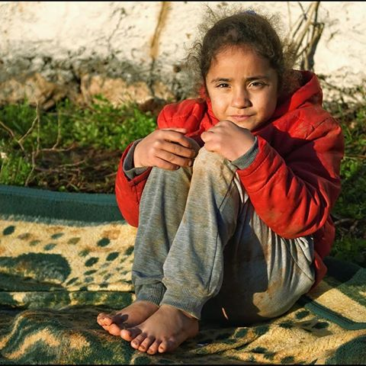
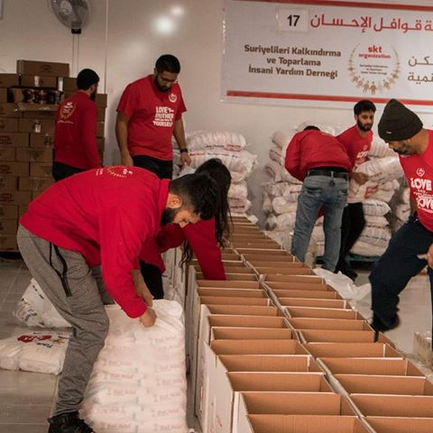
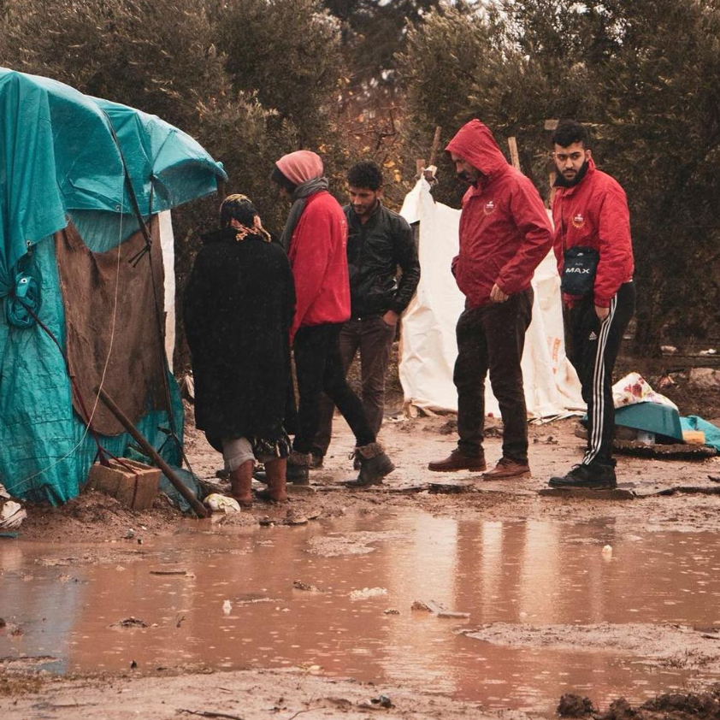
2. SKT welfare charity

Slide 4
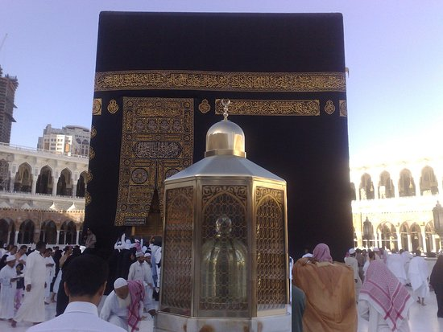
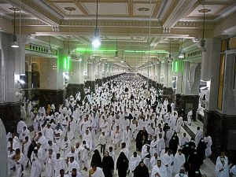
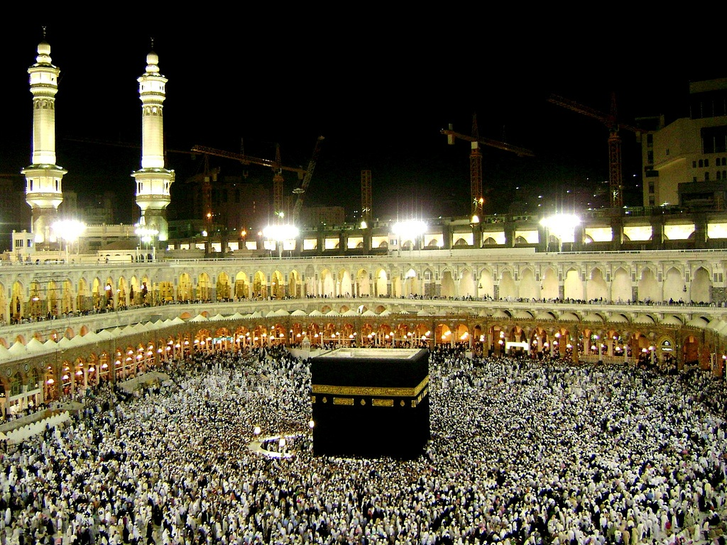
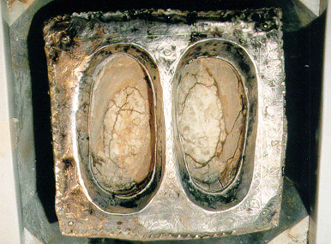

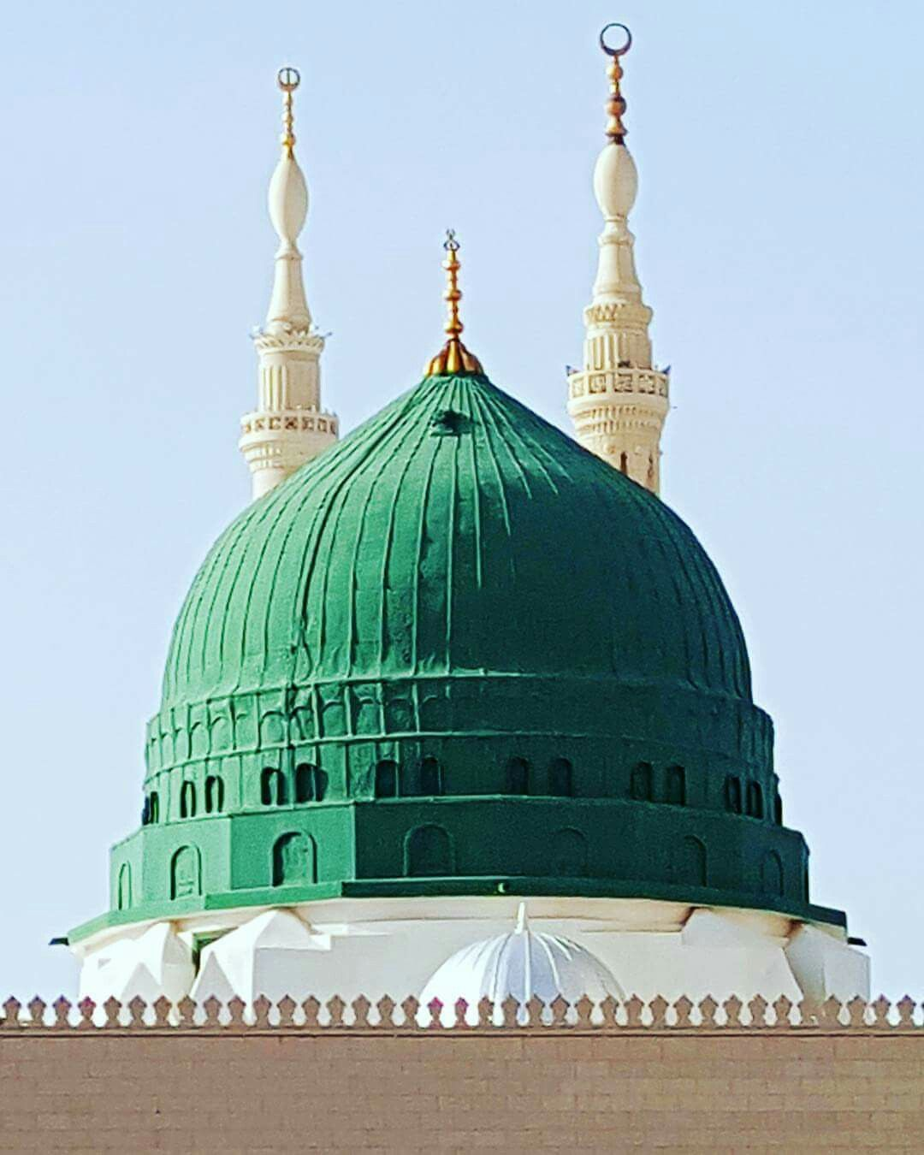
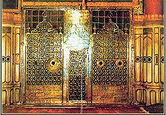
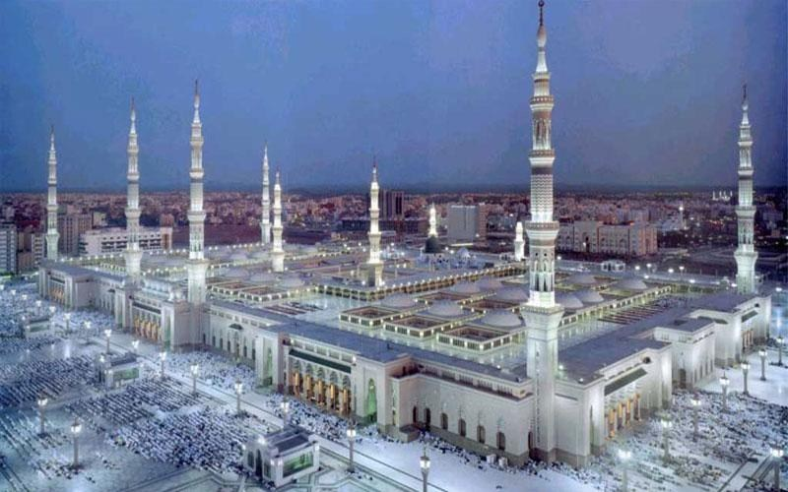
3. Makkah and Madinah

Slide 5
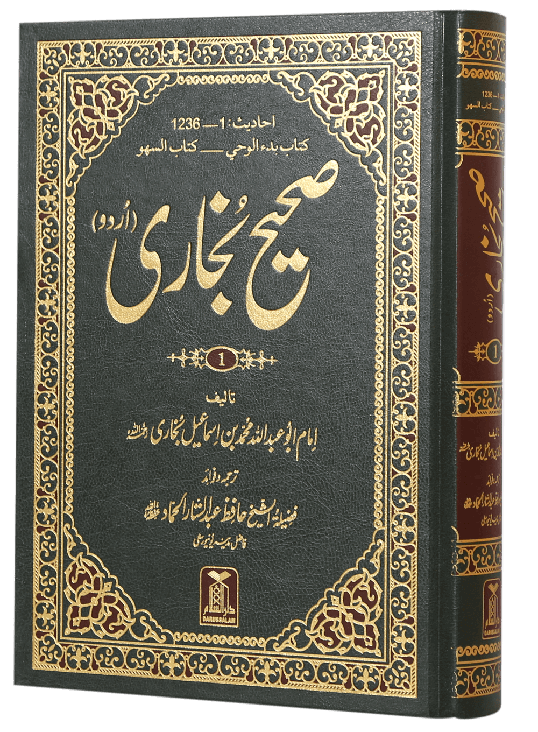
4. Islamic theology
‘Your smile for your brother is charity’
- Prophet Muhammad (SAW)
‘Cleanliness is half of your faith [imaan]’
- Prophet Muhammad (SAW)
‘Paradise lies beneath the feet of your mother’
- Prophet Muhammad (SAW)
‘Allah is displeased with the one whose father is displeased with him’
- Prophet Muhammad (SAW)

Slide 6
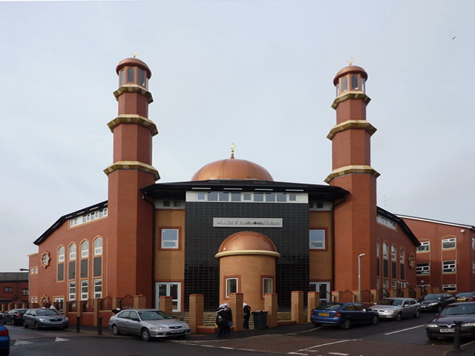
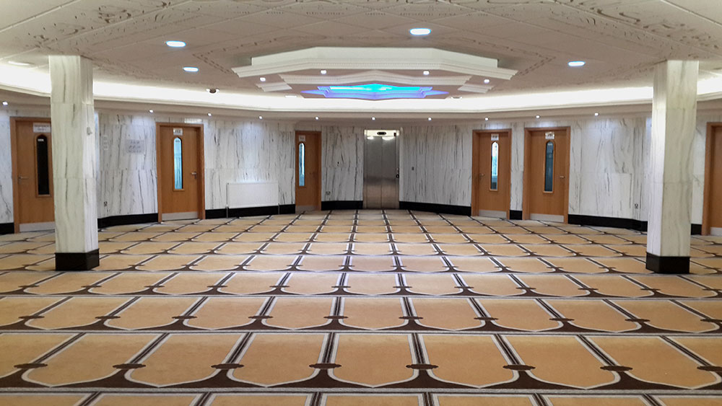
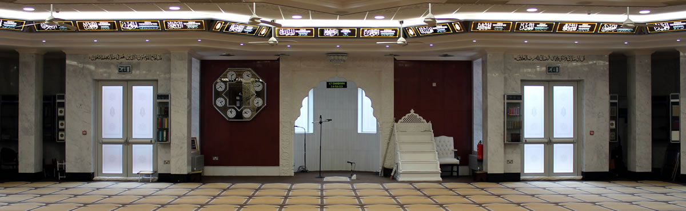
5. Madrasah Tauheedul Islam

Slide 7
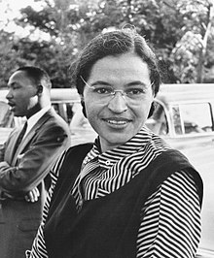
6. Rosa Parks
By refusing to give up her seat to a white man, she helped to initiate the civil rights movement in the US. Her actions led to the Montgomery bus boycott, led by the young reverend, Dr Martin Luther King. The boycott lasted more than one year- in which Rosa uncoincidentally lost her job- and ended when the US supreme court finally put a ban on bus segregation. Over the next 100 years, Rosa became a nationally recognised symbol of strength and dignity in the struggle to end racial segregation. Although the bus boycott happened in 1955, she was not awarded the Spingarn Medal by the NAACP (National Association for the Advancement of Coloured People) until 1979.

Slide 8

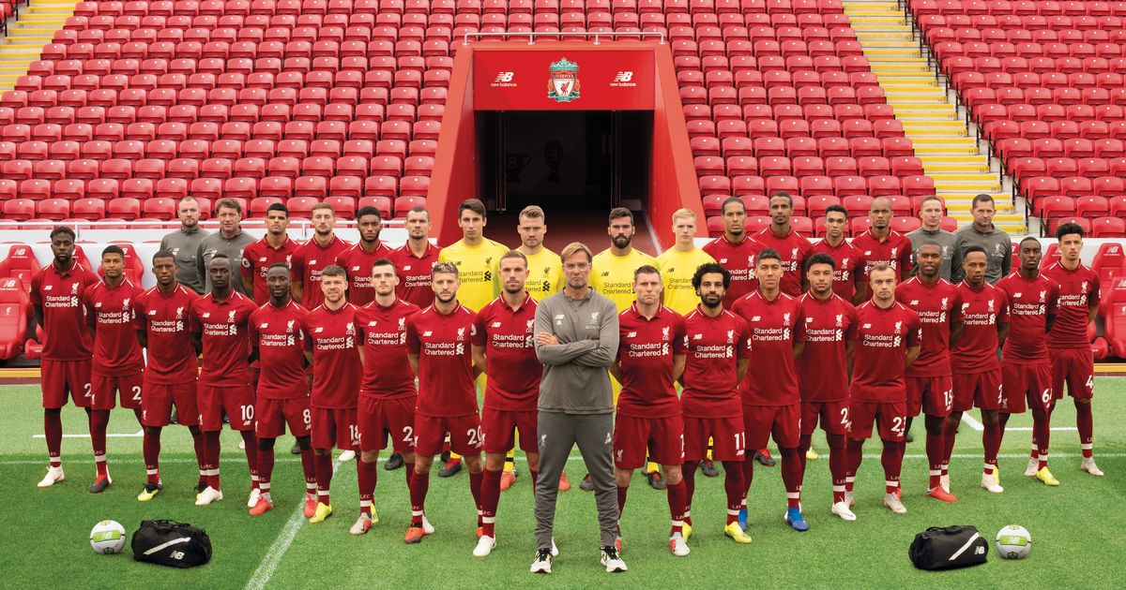

7. Liverpool Football Club

Slide 9

8. Biking

Slide 10


9. Baking

Slide 11

10. Travelling

Slide 12
Travelling:
Family
Childhood
Memories
Royal Manchester Children’s Hospital:
In honour of my best friend
Charity work
Helping youngsters
Baking:
Family
Friends
Creatitvity
SKT welfare charity:
Working with family to raise money
Charity work
Helping our fellow siblings
Family and Friends
Biking:
Family
Friends
Childhood
Makkah and Madinah:
Family
Religion
History
Liverpool Football Club:
Family
Friends
Childhood
Islamic theology:
In honour of my grandparents
Learning about my religion
Doing it with friends
Rosa Parks:
Black history movement
Family
Indirect lead of feminism
Madrasah Tauheedul Islam:
Grandfather
First mosque I went to
Religion

